Slide 1
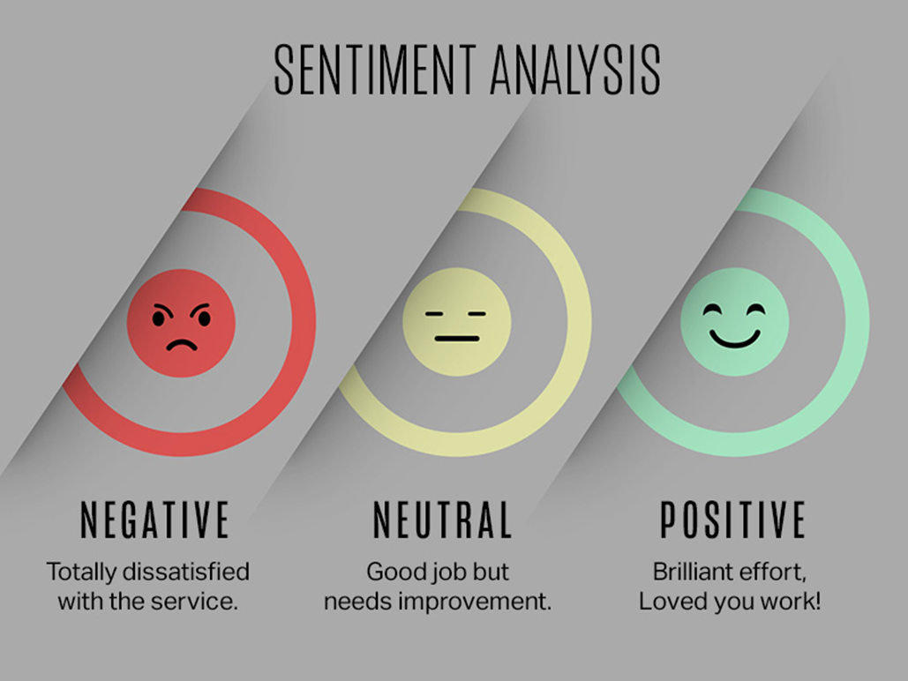
Financial News Sentiment Analysis Using Natural Language Processing (NLP)
Presented By:
Saketh Maryala

Slide 2
Agenda
NLP : Presentation
1. Defining the Problem
2. Data Preprocessing
3. EDA
4. Model Building
5. Prediction

Slide 3

Defining the Problem
NLP : Presentation
Problem Statement :
Companies face challenges in tracking sentiment across large volumes of media content. This project aims to build an automated sentiment analysis tool to classify business-related text (news, reports) as positive, negative, or neutral — helping organizations understand public perception and make strategic decisions

Slide 4
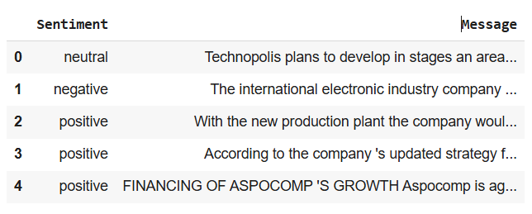
Overview
Dataset Overview:
•The dataset consists of 4,846 entries and contains two columns:
•Sentiment (neutral): This column represents the sentiment label of the financial news, with values such as "neutral," "negative," and "positive." It classifies the sentiment of the corresponding text in each row.
•Message: The second column contains financial news or statements. These text entries are used to analyze the sentiment of the news and classify them based on their content.
•No missing values are present in the dataset, indicating that both columns are fully populated.
•This dataset is structured for sentiment analysis, where the goal is to classify financial news into positive, negative, or neutral sentiment. By applying Natural Language Processing (NLP) techniques, we aim to build models that can automatically predict the sentiment of new financial articles.

Slide 5
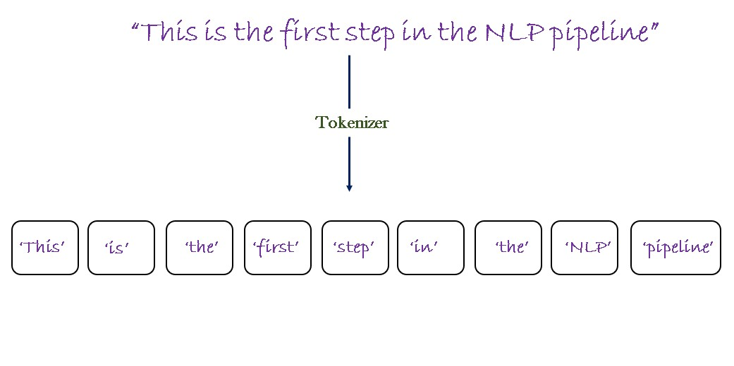
Text Preprocessing
Making Observations
NLP Presentation
Tokenization
Stop-words
Lemmatization
Stemming
Lowercasting

Slide 6

Data Analysis and Visualization
Data Analysis
Plotting
•Handling null Values
•Data Cleaning
•Data Preprocessing
•EDA

Slide 7
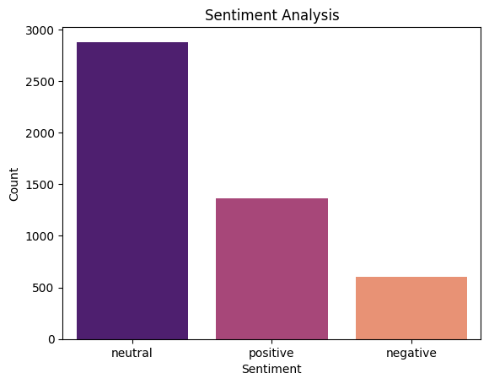
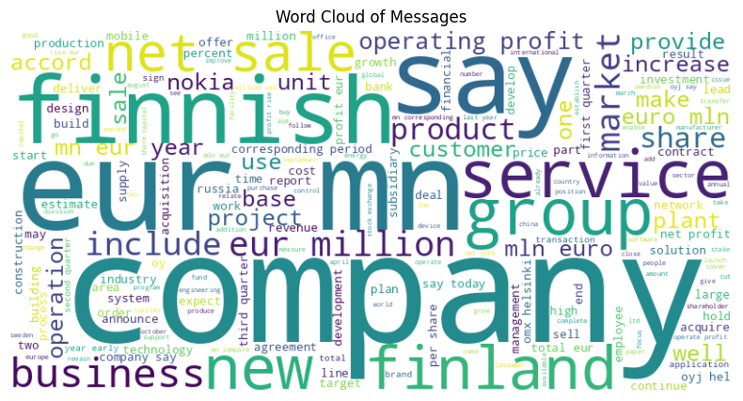
Two Key Points of the plot
Word Cloud of Messages
Data Analysis
NLP : Presentation
EDA : EXPLORATORY DATA ANALYSIS

Slide 8
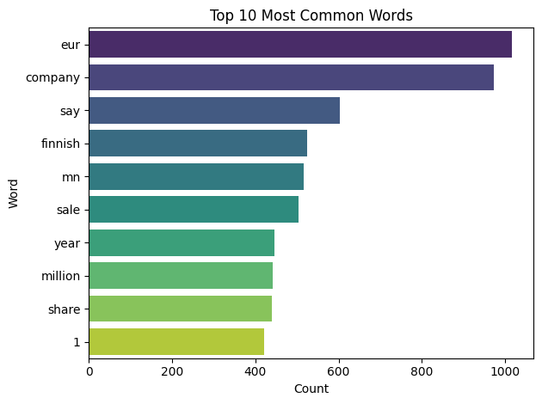
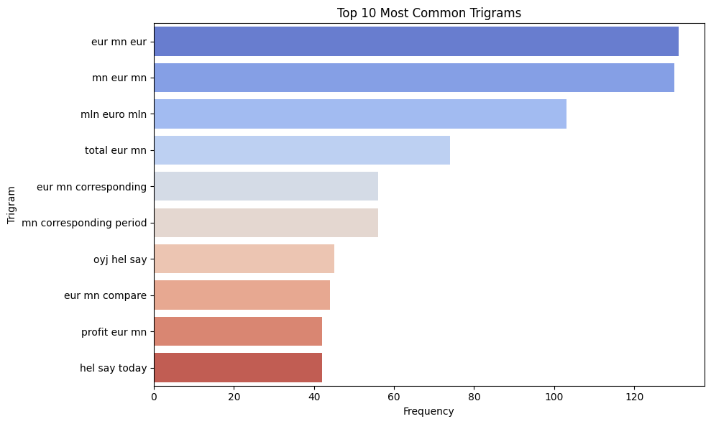
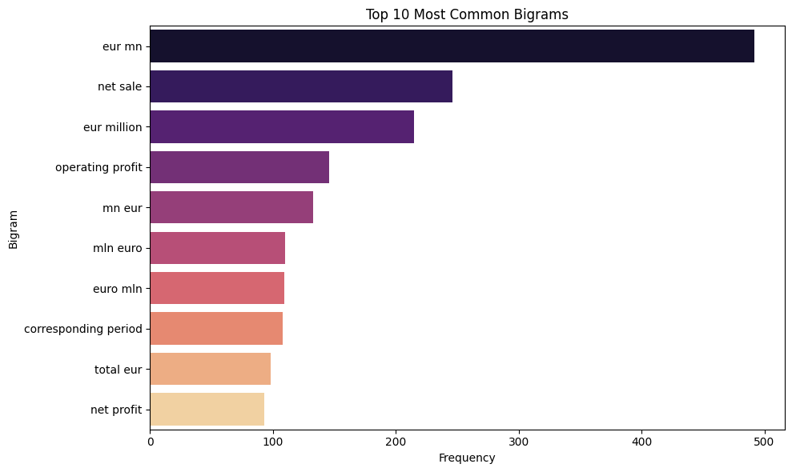
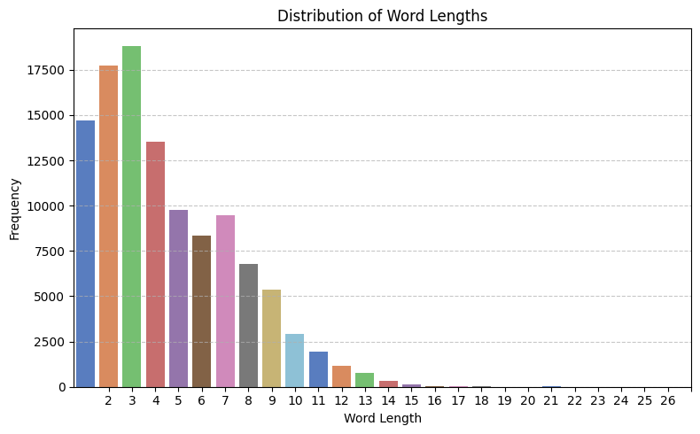
Top 10 Most Common Words
Top 10 Most Common Trigrams
Top 10 Most Common Bigrams
Distribution of Word Lengths

Slide 9
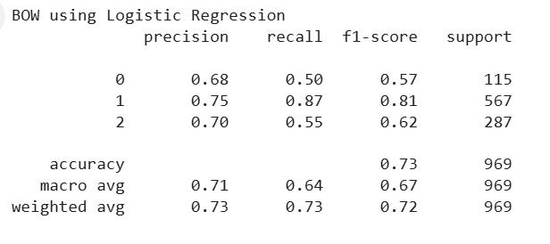
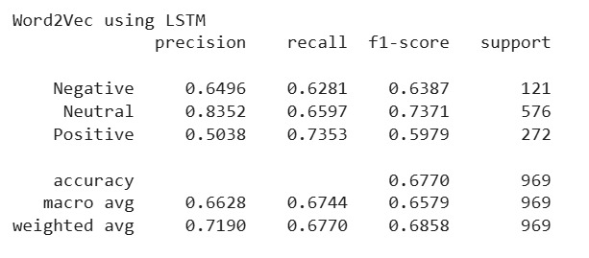
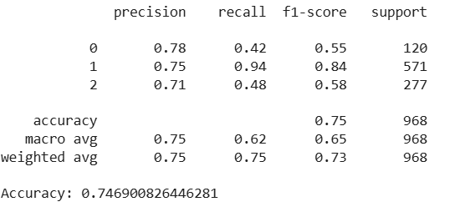
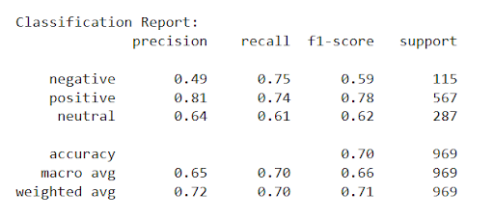
Model Training and Validation
Appendix
NLP Presentation
Logistic Regression using BOW
LSTM using Word2Vec
Random Forest using TF-IDF
LSTM using Glove

Slide 10
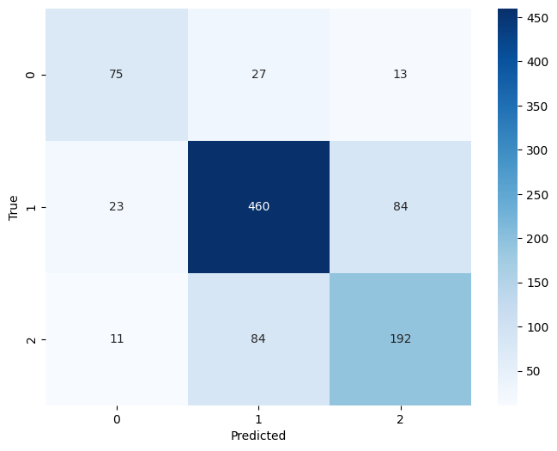
Confusion Matrix
Description:
The model performs best on class 1 with 460 correct predictions, but shows confusion between classes 1 and 2, each misclassified as the other 84 times.

Slide 11
Challenges
Learning
Challenges:​
•Data Preprocessing: Handling noisy and unstructured text data required significant cleaning and normalization.
•Model Overfitting: Balancing complexity while avoiding overfitting, especially with deep learning models.​
•Hyperparameter Tuning: Finding the optimal hyperparameters for LSTM and Word2Vec required extensive experimentation.​
​
Learning:​
•Model Optimization: Gained insights into optimizing models using techniques like dropout and regularization.​
•Text Representation: Learned how different embeddings (Word2Vec, GloVe) affect model performance.​
•Real-World Application: Understood the challenges of applying sentiment analysis to financial news for actionable insights.​

Slide 12
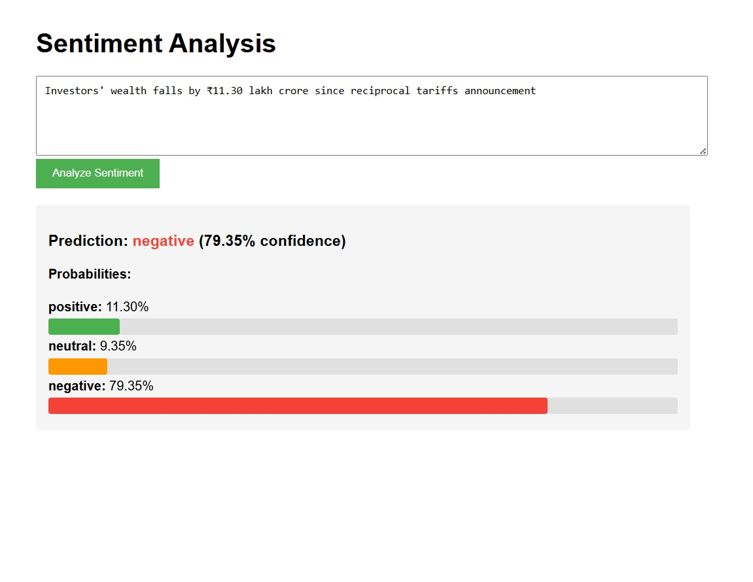
Web Application
Deployment
Sentiment Analysis Web Application

Slide 13
Conclusion
Successfully demonstrated advanced machine learning techniques for sentiment analysis of financial news.
Utilized LSTM combined with word embeddings such as Word2Vec and GloVe for accurate sentiment classification.
Achieved high accuracy in classifying sentiments as positive, negative, or neutral.
Performed careful hyperparameter tuning and thorough data preprocessing to optimize model performance.
The insights gained can help stakeholders make informed decisions based on market sentiment.
Potential for real-time sentiment analysis and future improvements to enhance decision-making processes.

Slide 14
Future
Enhancements
Future Enhancements
Incorporating Additional Features: Integrating more financial indicators, such as market trends or stock prices, to improve sentiment prediction accuracy.
Advanced Embedding Techniques: Experimenting with newer word embeddings like BERT or GPT for capturing deeper context and improving classification performance.
Real-time Sentiment Analysis: Implementing a real-time system for analyzing financial news sentiment, providing immediate insights for stakeholders.
Multi-lingual Support: Expanding the model to handle financial news in multiple languages for broader applicability.

Slide 15


